Slide 1
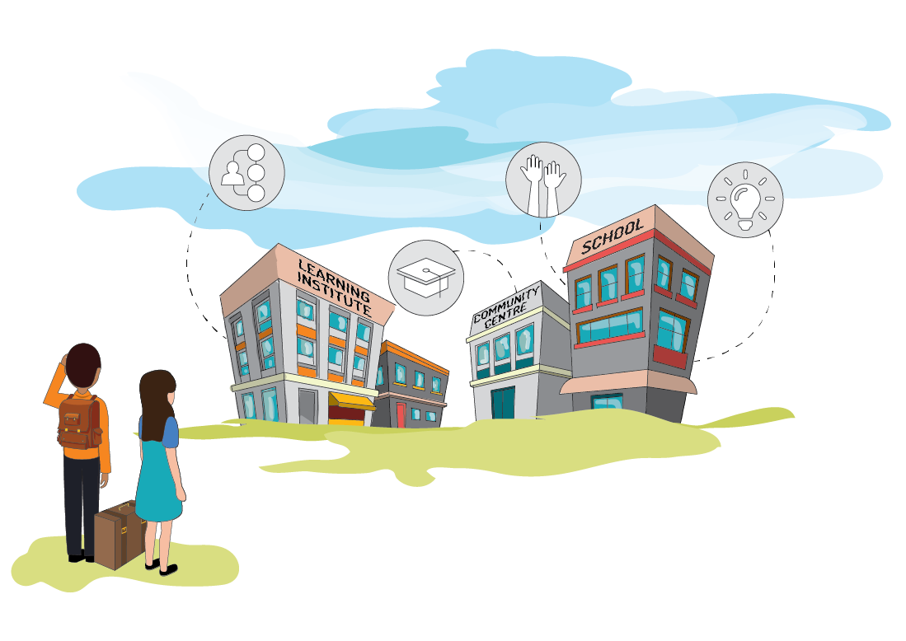
ALL I WANT A Training Tool for Migrant Training-The-Training Promoting Adult Education
Supporting Migrant Inclusion in Lifelong Learning and Education
http://www.project-smile.eu/en/
Erasmus + project KA 20426966
Foundation for Shelter and Support to Migrants (FSM, Malta) ,
CARDET (Cyprus), iFALL (Sweden), Institute for African Studies (IAS, Slovenia).

Slide 2
Introduction

Slide 3
Session outline
1. Democracy
Representation
Civil Societies
Rights & Freedoms
2. Human Rights & Conflict
Rights & Freedoms
Positions vs. Interests
Conflict Styles
3. Identity & Leadership
Culture
Gender Roles/ Awareness
Prejudice/ Discrimination
4. Confidence Building
Values
Attitude
Behaviour
5. “What’s Next?”
Positionality
Future
Feedback/ Evaluation

Slide 4
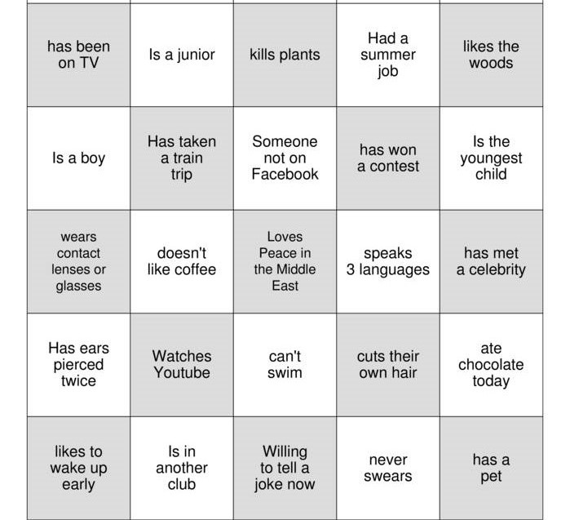
Icebreaker
People Bingo
Notes:
Exercise 1: People Bingo

Slide 6
Introduction
Why ‘ALL ….I want’?
Why is fear mentioned?
Who is ‘NOONE’ ?
What is the price? What are you willing to pay?
Why ‘ALL ….I want’?
Why is fear mentioned?
Who is ‘NO ONE’?
What is the price? What are you willing to pay?

Slide 7
Expectations
What is your name?
What do you hope to get out of the course?
What could be the craziest thing that could happen if your expectations are met?
Notes:
Exercise 2: Expectations

Slide 8
When can a course be considered as successful?
Think for 1 min (generate 3 answers)
Pair (see what you agree upon)
Pair with pair (see what you agree upon)
Group (share the 3 most important requirements)
Notes:
Exercise 3: Snowball

Slide 9
1. Democracy
Autonomy/Representation
Civil Societies
Rights & Freedoms

Slide 10
Democracy
Why ‘ALL ….I want’?
Why is fear mentioned?
Who is ‘NOONE’ ?
What is the price? What are you willing to pay?
What is “democracy”?
What do you think about the concept of democracy?
What form of government do you have in your country of origin?
What form of government does this country have?
Notes:
Exercise 4: Real-time reactions

Slide 11
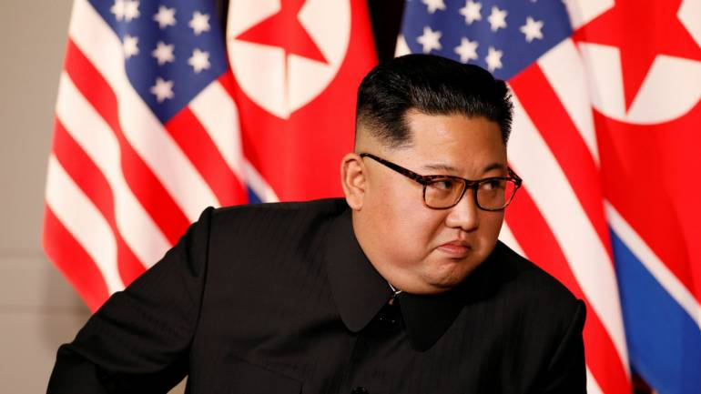
Is this Democracy?
Why ‘ALL ….I want’?
Why is fear mentioned?
Who is ‘NOONE’ ?
What is the price? What are you willing to pay?
Who is he?
From which country is he the ruler?
He is the leader of which country?
Is this form of government considered as democracy? Why?
Why is or is this not a democracy?

Slide 12
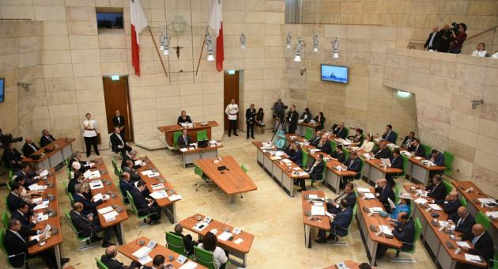
Definition
Why ‘ALL ….I want’?
Why is fear mentioned?
Who is ‘NOONE’ ?
What is the price? What are you willing to pay?
People are entitled to influence important decisions that affect their lives.
Power is not in the hands of one individual.
Democracy is ruled by the majority.

Slide 13
European Union
28 member countries
Citizen of one -> can live/work in any of the other 27 member countries
Euro is valuta for most EU countries
What does the EU mean to you?
How does it influence your life?
Why ‘ALL ….I want’?
Why is fear mentioned?
Who is ‘NOONE’ ?
What is the price? What are you willing to pay?

Slide 14
European Union
Real-time reactions
Why ‘ALL ….I want’?
Why is fear mentioned?
Who is ‘NOONE’ ?
What is the price? What are you willing to pay?

Slide 15
Break
Enter number of minutes

Slide 16
Civil society
Why ‘ALL ….I want’?
Why is fear mentioned?
Who is ‘NOONE’ ?
What is the price? What are you willing to pay?
What does “Civil Society” means?
Think-pair-share
What are the different kind of organisations which are part of the civil society?
Serves the public interest but is not part of the government
Notes:
Exercise 5: Think-pair-share

Slide 17
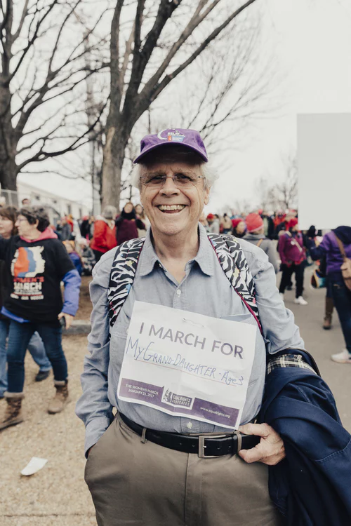
Civil society
Why ‘ALL ….I want’?
Why is fear mentioned?
Who is ‘NOONE’ ?
What is the price? What are you willing to pay?
Who has been part of a civil society movement?

Slide 18
Pro-con grid
Why ‘ALL ….I want’?
Why is fear mentioned?
Who is ‘NOONE’ ?
What is the price? What are you willing to pay?
Three arguments to support the statement
Three arguments to oppose the statement
Share and discuss
All countries should be obliged to have a democratic government in place.
or
A democracy can not be established without a strong civil society movement.
Notes:
Exercise 6: Pro-con grid

Slide 19
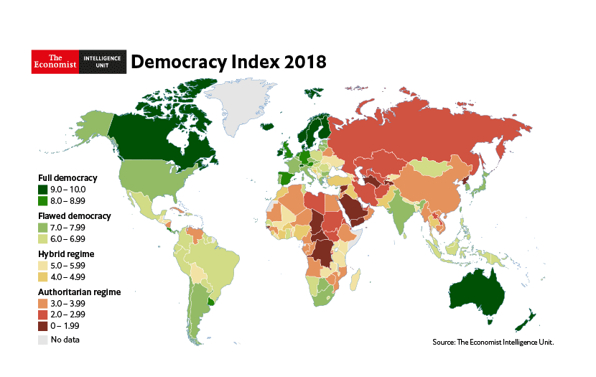
Case study democracy in Europe
Choose a country
Group together
Guidelines and criteria
Divide work
Present your work during the next session
Why ‘ALL ….I want’?
Why is fear mentioned?
Who is ‘NOONE’ ?
What is the price? What are you willing to pay?
Notes:
Exercise 7: Case study

Slide 20
Recap
“I was surprised that …”
“I learned that...”
“I wonder about...”
Why ‘ALL ….I want’?
Why is fear mentioned?
Who is ‘NOONE’ ?
What is the price? What are you willing to pay?
Notes:
Exercise 8: Surprise

Slide 21
Welcome Session 2

Slide 22
Two Truths and a Lie
Notes:
Exercise 9: Two Truths and a Lie

Slide 23
Session outline
1. Democracy
Representation
Civil Societies
Rights & Freedoms
2. Human Rights & Conflict
Rights & Freedoms
Positions vs. Interests
Conflict Styles
3. Identity & Leadership
Culture
Gender Roles/ Awareness
Prejudice/ Discrimination
4. Confidence Building
Values
Attitude
Behaviour
5. “What’s Next?”
Positionality
Future
Feedback/ Evaluation

Slide 24
Starting point
“What do you think about the universal human rights?”
Notes:
Exercise 10: Starting point

Slide 25
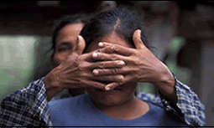
Human rights
Why ‘ALL ….I want’?
Why is fear mentioned?
Who is ‘NOONE’ ?
What is the price? What are you willing to pay?
Inherent to all human beings
We are all equally entitled to our human rights without discrimination
Universal human rights are often expressed and guaranteed by laws
International human rights law lays down obligations of Governments to promote and protect human rights and fundamental freedoms of individuals or groups

Slide 26
Human rights
Why ‘ALL ….I want’?
Why is fear mentioned?
Who is ‘NOONE’ ?
What is the price? What are you willing to pay?
Both rights and obligations
The Universal Declaration of Human Rights (UDHR) establishes the civil, political, economic, social, and cultural rights of all people

Slide 27
Which rights do you think will be in this document?

Slide 28
On many different area’s
Right to education
Freedom from discrimination
Right to asylum
No torture
Right to a nationality
Freedom of thought
Social security
No one can take away your human rights

Slide 29
Education
What is your experience regarding education?
What are the challenges to continuing education as an adult?
What are the opportunities available and how can people access them?
What can we do to improve access to education for our community?

Slide 30
What is the link between human rights and conflict?

Slide 31
Human rights are the first casualties of civil conflict

Slide 32
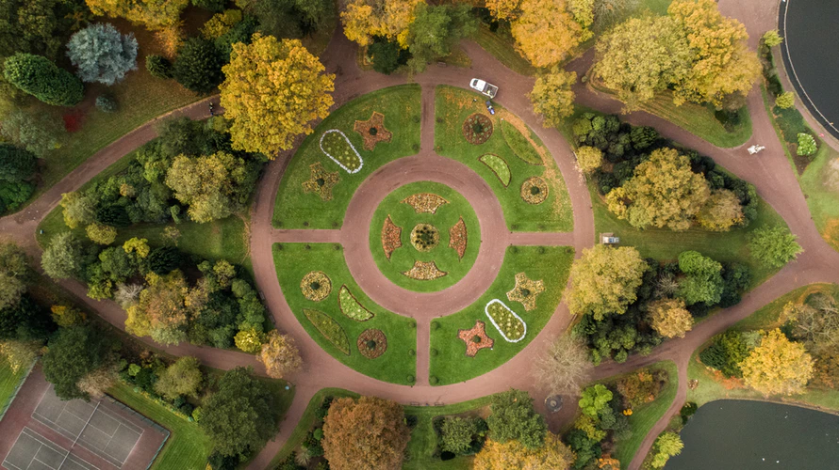
Round table
Why ‘ALL ….I want’?
Why is fear mentioned?
Who is ‘NOONE’ ?
What is the price? What are you willing to pay?
Trainer shares a statement/question
Each person, in turn around the circle, provides a comment
Not wish to comment -> “pass.”
Notes:
Exercise 12: Round table

Slide 33
Add selected question(s). Notes exercise 12

Slide 34
United Nations Human Rights Council
Why ‘ALL ….I want’?
Why is fear mentioned?
Who is ‘NOONE’ ?
What is the price? What are you willing to pay?
Established 15 March 2006
UN intergovernmental body is responsible for human rights
The Council consists of 47 member States
Task: Strengthening the promotion and protection of human rights around the globe by addressing situations of human rights violations and making recommendations on them, including responding to human rights emergencies.

Slide 35
Break
Enter number of minutes

Slide 36
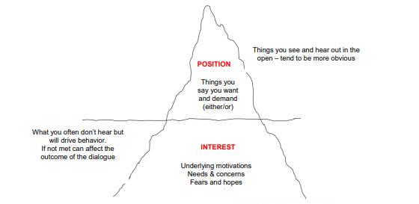
Positions vs. Interests
Share a particular conflict (detailed, including background information, people involved, outcome etc.)
Examine:
parties involved
positions of each party
interests of each party
escalation/de-escalation
resolution
Why ‘ALL ….I want’?
Why is fear mentioned?
Who is ‘NOONE’ ?
What is the price? What are you willing to pay?
Notes:
Exercise 17

Slide 37
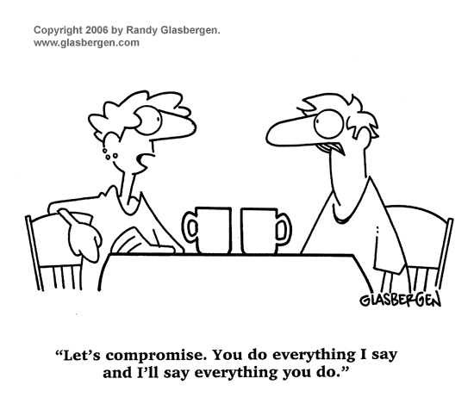
Positions vs. Interests
Make the quiz
You have 4 min for the 12 questions
We will discuss the answers as a group
Why ‘ALL ….I want’?
Why is fear mentioned?
Who is ‘NOONE’ ?
What is the price? What are you willing to pay?
Notes:
Exercise 13: Quiz

Slide 38
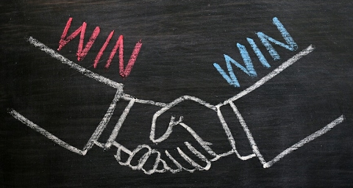
Positions vs. Interests
Can you give examples of a win-win solution in your own life?
Why ‘ALL ….I want’?
Why is fear mentioned?
Who is ‘NOONE’ ?
What is the price? What are you willing to pay?
Notes:
Exercise 17

Slide 39
Conflict styles
Confrontation
Accommodation
Compromise
Competition
Avoidance
Why ‘ALL ….I want’?
Why is fear mentioned?
Who is ‘NOONE’ ?
What is the price? What are you willing to pay?

Slide 40
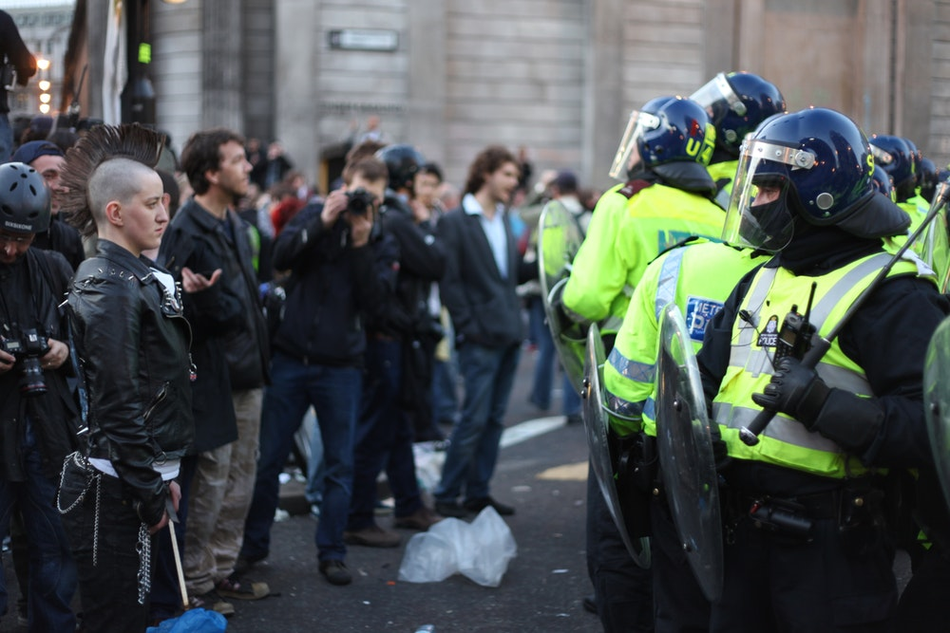
Comparing conflict in your country of origin and residence
Which conflict style is mostly accepted in your home country?
Is that different for your country of residence?
What would have happened if you had addressed issues the same way in your country of residence as you would have back home?
What is your personal conflict style?
Why ‘ALL ….I want’?
Why is fear mentioned?
Who is ‘NOONE’ ?
What is the price? What are you willing to pay?
Notes:
Exercise 17

Slide 41
Conflict Close-up activity
I am conflict.
Consider how you typically react when you experience a personal conflict.
Position yourself, in relation to me, somewhere in the room in a way that conveys your initial response to a conflict.
Pay attention to your body language as well as your distance from the conflict.
Why ‘ALL ….I want’?
Why is fear mentioned?
Who is ‘NOONE’ ?
What is the price? What are you willing to pay?
Notes:
Exercise 14: Conflict Close-up activity

Slide 42
Sketchnoting
Visualise what you have learned
New understanding you gained
Why ‘ALL ….I want’?
Why is fear mentioned?
Who is ‘NOONE’ ?
What is the price? What are you willing to pay?
Notes:
Exercise 15: Sketchnoting

Slide 43
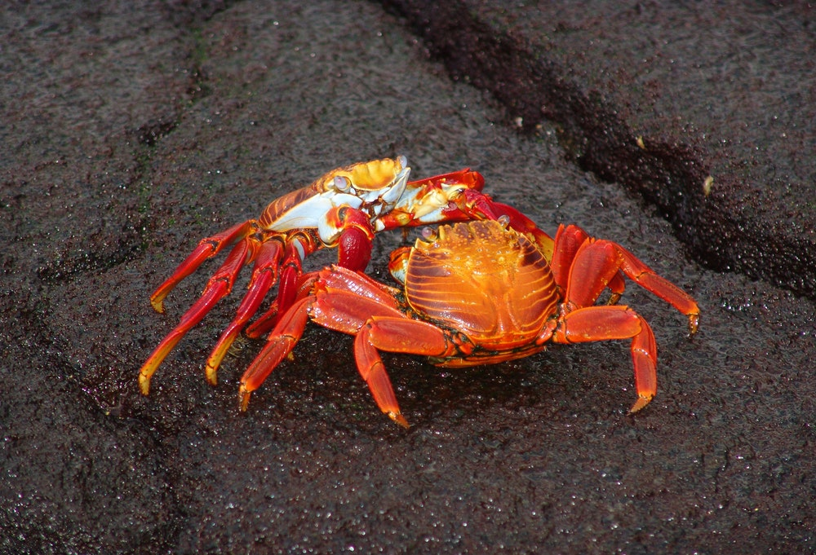
Do the test
Homework:
What is your conflict style?
For the next session, bring questions you have about identity and leadership and we will discuss them.
Why ‘ALL ….I want’?
Why is fear mentioned?
Who is ‘NOONE’ ?
What is the price? What are you willing to pay?
Notes:
Exercise 16: test your own conflict style

Slide 44
Welcome Session 3

Slide 45
Solarium
Notes:
Exercise 17: Solarium

Slide 46
Session outline
1. Democracy
Representation
Civil Societies
Rights & Freedoms
2. Human Rights & Conflict
Rights & Freedoms
Positions vs. Interests
Conflict Styles
3. Identity & Leadership
Culture
Gender Roles/ Awareness
Prejudice/ Discrimination
4. Confidence Building
Values
Attitude
Behaviour
5. “What’s Next?”
Positionality
Future
Feedback/ Evaluation

Slide 47
Conflict styles
Homework:
What is your conflict style?
Why ‘ALL ….I want’?
Why is fear mentioned?
Who is ‘NOONE’ ?
What is the price? What are you willing to pay?
Notes:
Exercise 16: test your own conflict style

Slide 48
Extending borders
How can we cultivate a global mindset?
Why ‘ALL ….I want’?
Why is fear mentioned?
Who is ‘NOONE’ ?
What is the price? What are you willing to pay?
Notes:
Min 1 to 7.05

Slide 49
Extending borders
Culture:
“The way of life, especially the general customs and beliefs, of a particular group of people at a particular time.”
(Cambridge dictionary)
Cross-cultural communication
Why ‘ALL ….I want’?
Why is fear mentioned?
Who is ‘NOONE’ ?
What is the price? What are you willing to pay?

Slide 51
Complete turn taking
Use prepared questions of participants (or example questions)
One student reads a question out loud
The student on the left has one minute of uninterrupted time to speak and give his/her thoughts
“OK, I’m done”
The next person to the left goes, has one minute of uninterrupted time to speak
“OK, I’m done”
The discussion is open to the whole group for two minutes.
Why ‘ALL ….I want’?
Why is fear mentioned?
Who is ‘NOONE’ ?
What is the price? What are you willing to pay?
Notes:
Exercise 18: Complete turn taking

Slide 52
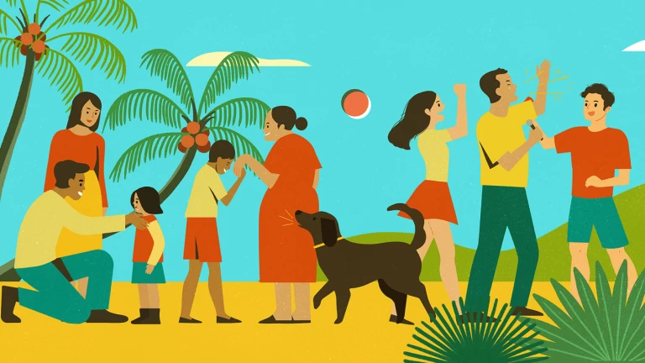
Culture
Which areas make up culture?
Brainstorm out loud
Why ‘ALL ….I want’?
Why is fear mentioned?
Who is ‘NOONE’ ?
What is the price? What are you willing to pay?

Slide 53
Culture
Culture is the way you think, act and interact.
Why ‘ALL ….I want’?
Why is fear mentioned?
Who is ‘NOONE’ ?
What is the price? What are you willing to pay?

Slide 54
Gender roles & awareness
Gender stereotyping refers to the practice of ascribing to an individual woman or man specific attributes, characteristics, or roles by reason only of her or his membership in the social group of women or men. Gender stereotyping is wrongful when it results in a violation or violations of human rights and fundamental freedoms.
Why ‘ALL ….I want’?
Why is fear mentioned?
Who is ‘NOONE’ ?
What is the price? What are you willing to pay?

Slide 55
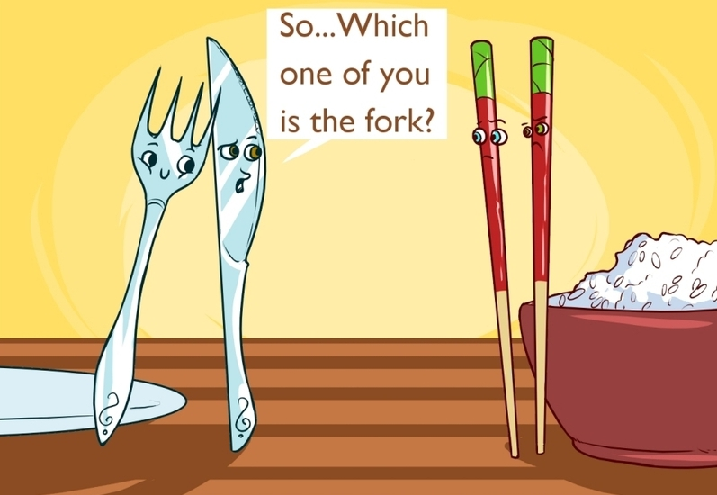
Gender roles & awareness
What does it mean to you to be a male or a female?
What does it mean to be identified as non-binary?
Provide some examples of harmful stereotypes.
Give some examples of ways you can fight negative gender stereotypes.
Why ‘ALL ….I want’?
Why is fear mentioned?
Who is ‘NOONE’ ?
What is the price? What are you willing to pay?

Slide 56
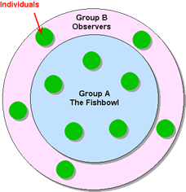
Fishbowl exercise
Depends on the questions you want to discuss.
Why ‘ALL ….I want’?
Why is fear mentioned?
Who is ‘NOONE’ ?
What is the price? What are you willing to pay?
Notes:
Exercise 19: Fishbowl

Slide 57
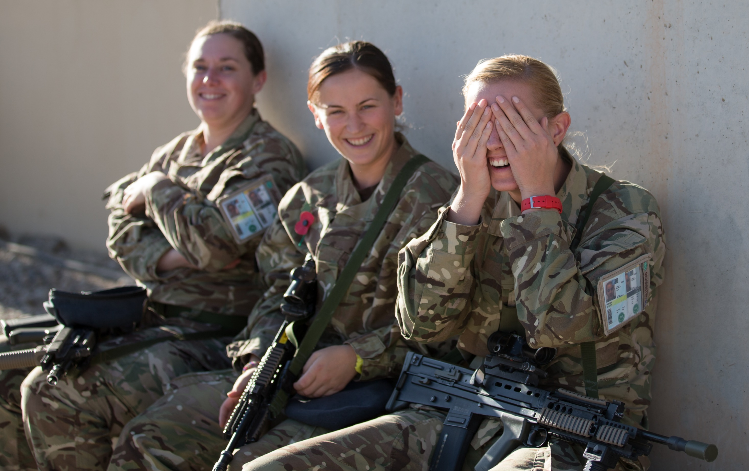

Slide 58
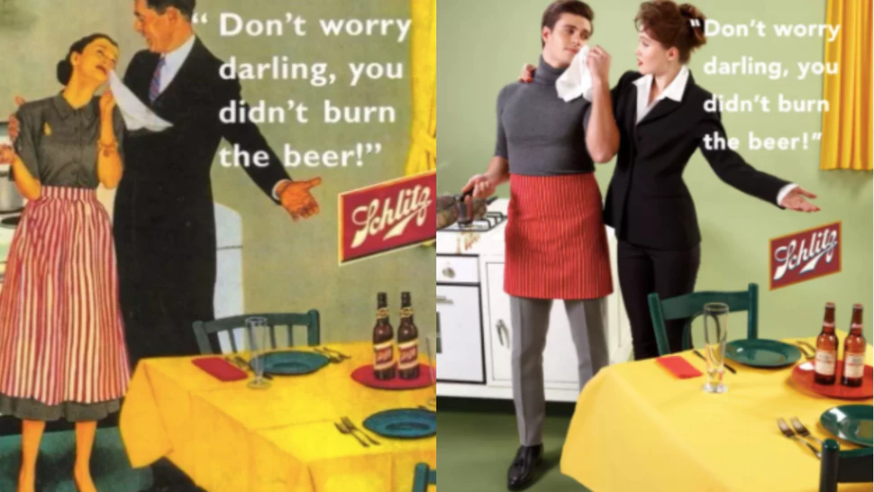

Slide 60
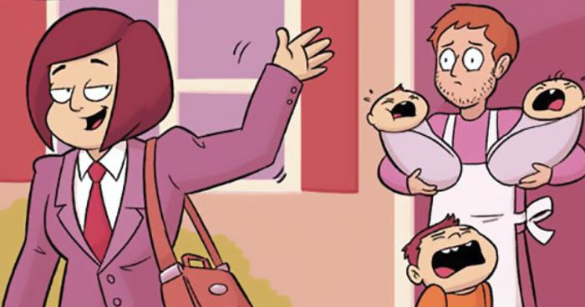

Slide 61
Break
Indicate number of minutes

Slide 62
Gender roles & awareness
What is the gender norm in your country of origin?
How is it different here?
What are your thoughts about gender equality?
Does that shape your capacity to interact with others who do or do not perceive themselves as male or female? If so, in what ways?
Why ‘ALL ….I want’?
Why is fear mentioned?
Who is ‘NOONE’ ?
What is the price? What are you willing to pay?

Slide 63
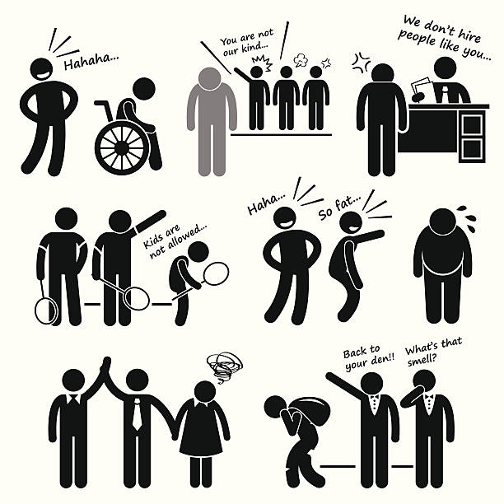
Prejudice vs. Discrimination
What is the difference between the two?
Why ‘ALL ….I want’?
Why is fear mentioned?
Who is ‘NOONE’ ?
What is the price? What are you willing to pay?
Notes:
Min 1 to 7.05

Slide 64
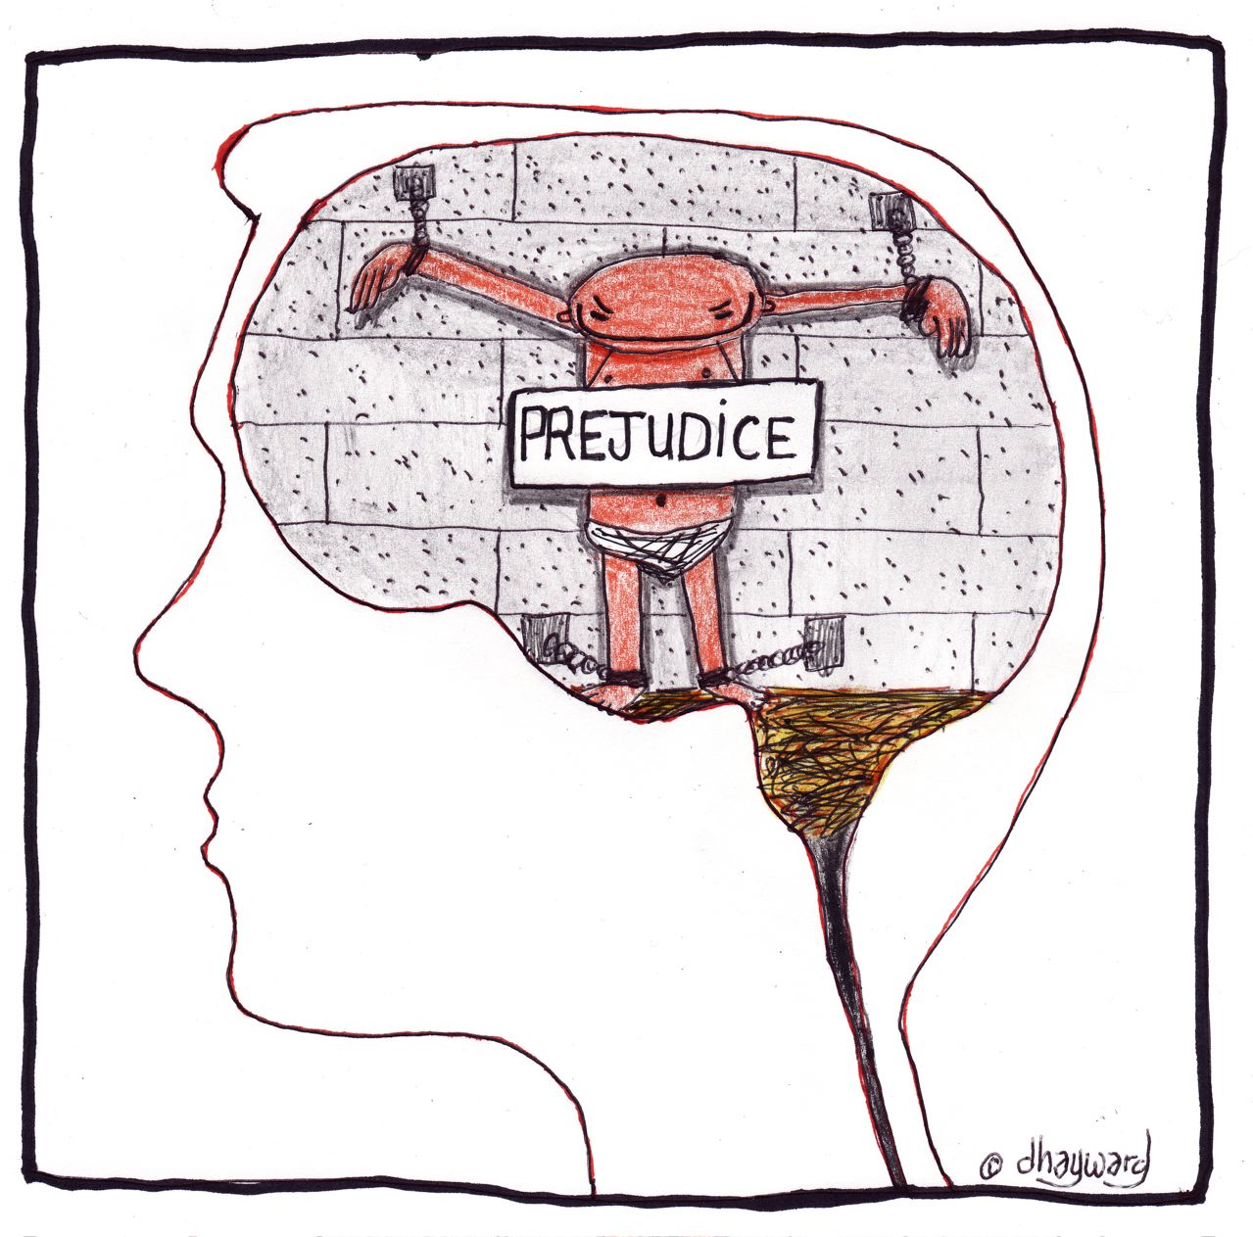
Prejudice game
Think about general prejudices you have
Identify prejudices you might have about the person sitting next to you
Share and give space to respond
We all have them!
Most of prejudices are correct
How are prejudices constructed/come into existence?
Why ‘ALL ….I want’?
Why is fear mentioned?
Who is ‘NOONE’ ?
What is the price? What are you willing to pay?
Notes:
Exercise 20: Prejudices

Slide 65
Prejudice vs. Discrimination
Prejudice has to do with the inflexible and irrational attitudes and opinions held by members of one group about another.
Discrimination refers to behaviours directed against another group.
How can you fight against prejudice and discrimination?
Why ‘ALL ….I want’?
Why is fear mentioned?
Who is ‘NOONE’ ?
What is the price? What are you willing to pay?

Slide 66
Prejudice vs. Discrimination
Why ‘ALL ….I want’?
Why is fear mentioned?
Who is ‘NOONE’ ?
What is the price? What are you willing to pay?
What is discrimination?

Slide 67
Prejudice vs. Discrimination
Who can share personal experiences of a prejudice or discrimination?
How did it make you feel?
Do you always have to act on your prejudices?
How can you fight against prejudice and discrimination?
Why ‘ALL ….I want’?
Why is fear mentioned?
Who is ‘NOONE’ ?
What is the price? What are you willing to pay?

Slide 68
Prejudice vs. Discrimination
How can you go about fitting in to the new country?
Assimilation
Separation
Integration
Marginalization
Why ‘ALL ….I want’?
Why is fear mentioned?
Who is ‘NOONE’ ?
What is the price? What are you willing to pay?

Slide 69
Welcome Session 4

Slide 70
Question Ball
This is your change
Ask any question you like
Notes:
Excises 22: Question Ball

Slide 71
Session outline
1. Democracy
Autonomy/
Representation
Civil Societies
Rights & Freedoms
2. Human Rights & Conflict
Rights & Freedoms
Positions vs. Interests
Conflict Styles
3. Identity & Leadership
Culture
Gender Roles/ Awareness
Prejudice/ Discrimination
4. Confidence Building
Values
Attitude
Behaviour
5. “What’s Next?”
Positionality
Future
Feedback/ Evaluation

Slide 72
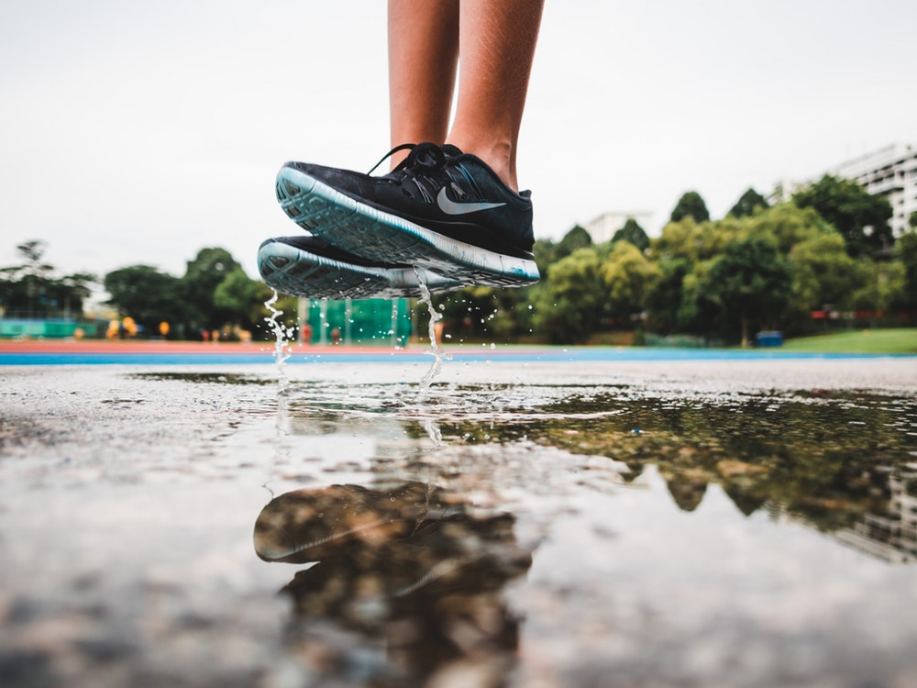
Confidence building
Education is important for everyone
Education pathways
Education systems
Education services
Clarity can help you explain
Patience can help you build trust
Determination can help you learn
Why ‘ALL ….I want’?
Why is fear mentioned?
Who is ‘NOONE’ ?
What is the price? What are you willing to pay?

Slide 73
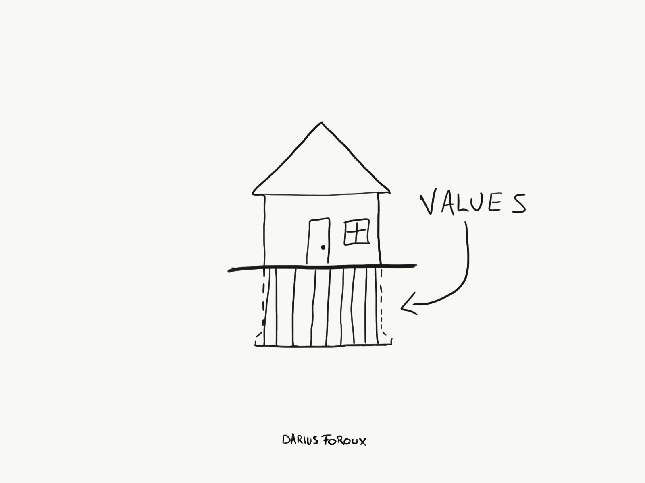
Values
Why ‘ALL ….I want’?
Why is fear mentioned?
Who is ‘NOONE’ ?
What is the price? What are you willing to pay?
What could this picture mean?
What are values and where do they come from?

Slide 74
Identify your own key values
1. When were you happiest (both in personal and professional life)? Questions that will help you define it: - What were you doing? - Were you with others? Who? - What other factors contributed to your happiness?
2. When were you most proud? - Why were you proud? - Did other people share your pride? Who? - What other factors contributed to your feelings of pride?
Why ‘ALL ….I want’?
Why is fear mentioned?
Who is ‘NOONE’ ?
What is the price? What are you willing to pay?
Notes:
Exercise 23: Identify values

Slide 75
Identify your own key values
3. When were you most fulfilled and satisfied? - What needs or desires were fulfilled? - Why and how did the experience give you meaning? - What other factors contributed to your feeling of fulfilment?
4. Determine your top values based on the outcomes 1-3. Use the provided list of common personal values - aim for about 10 top values.
5. Prioritise your top values Reduce 10 to 5 “If I could satisfy only one of these, which would I choose?"
Why ‘ALL ….I want’?
Why is fear mentioned?
Who is ‘NOONE’ ?
What is the price? What are you willing to pay?

Slide 76
Identify your own key values
Why ‘ALL ….I want’?
Why is fear mentioned?
Who is ‘NOONE’ ?
What is the price? What are you willing to pay?
6. Reaffirm your values:
Do these values make you feel good about yourself?
Are you proud of your top three values?
Would you be comfortable and proud to tell your values to people you respect and admire?
Do these values represent things you would support, even if your choice isn't popular, and it puts you in the minority?

Slide 77
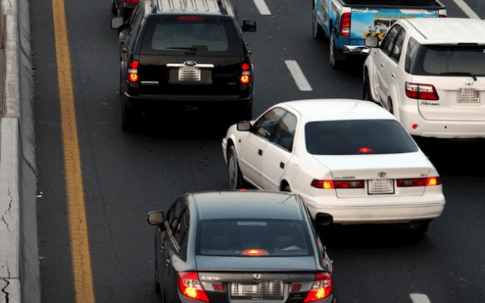
Confidence building
Why ‘ALL ….I want’?
Why is fear mentioned?
Who is ‘NOONE’ ?
What is the price? What are you willing to pay?
Start small - think big
Accreditation of prior learning may be difficult
Deciding on changing lanes
Mothers and children
Critical thinking
Creativity
Multiple identities

Slide 78
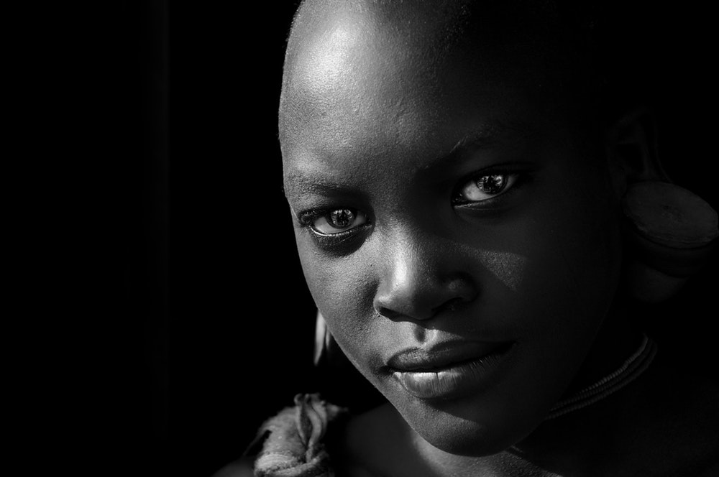
Confidence building
Why ‘ALL ….I want’?
Why is fear mentioned?
Who is ‘NOONE’ ?
What is the price? What are you willing to pay?
Recall two moments in which your confidence was built.
Recall two moments in which you built someone else’s confidence (this can be either very intentional or less intentional).
Would you change your approach when building up confidence for yourself and others? If yes, can you specify the approach you would follow?
Notes:
Exercise 24: Confidence

Slide 79
Confidence building
Why ‘ALL ….I want’?
Why is fear mentioned?
Who is ‘NOONE’ ?
What is the price? What are you willing to pay?
Identify influential attitudes/behaviours which influenced the outcome of a scenario
Share the complete story
Play the scenario
Notes:
Exercise 25: Role-play

Slide 80
Break
Identify number of minutes

Slide 81
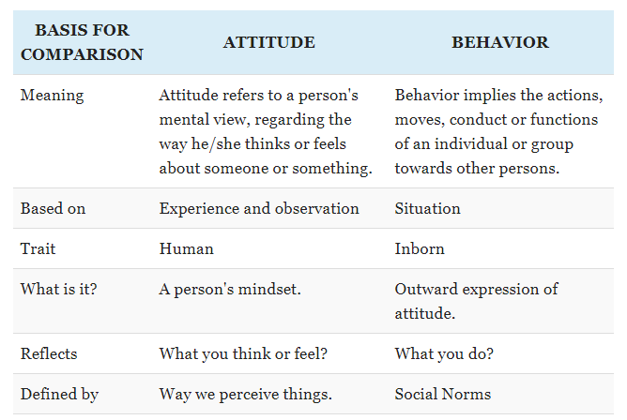
Attitude vs Behaviour
Why ‘ALL ….I want’?
Why is fear mentioned?
Who is ‘NOONE’ ?
What is the price? What are you willing to pay?
What is the difference?
Notes:
Exercise…

Slide 82
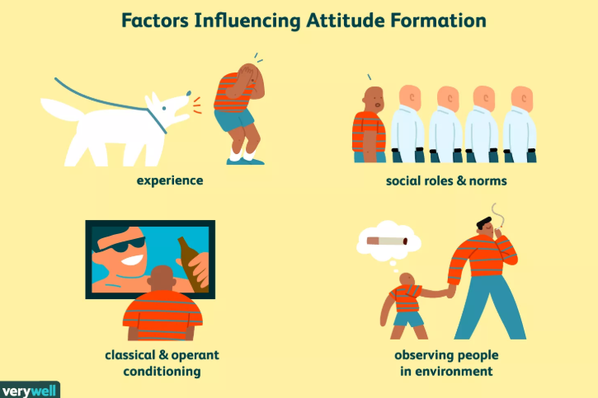
Attitude
Why ‘ALL ….I want’?
Why is fear mentioned?
Who is ‘NOONE’ ?
What is the price? What are you willing to pay?
An attitude is “a relatively enduring organization of beliefs, feelings, and behavioral tendencies towards socially significant objects, groups, events or symbols.”
(Hogg & Vaughan 2005, p. 150)
Notes:
Exercise…

Slide 83
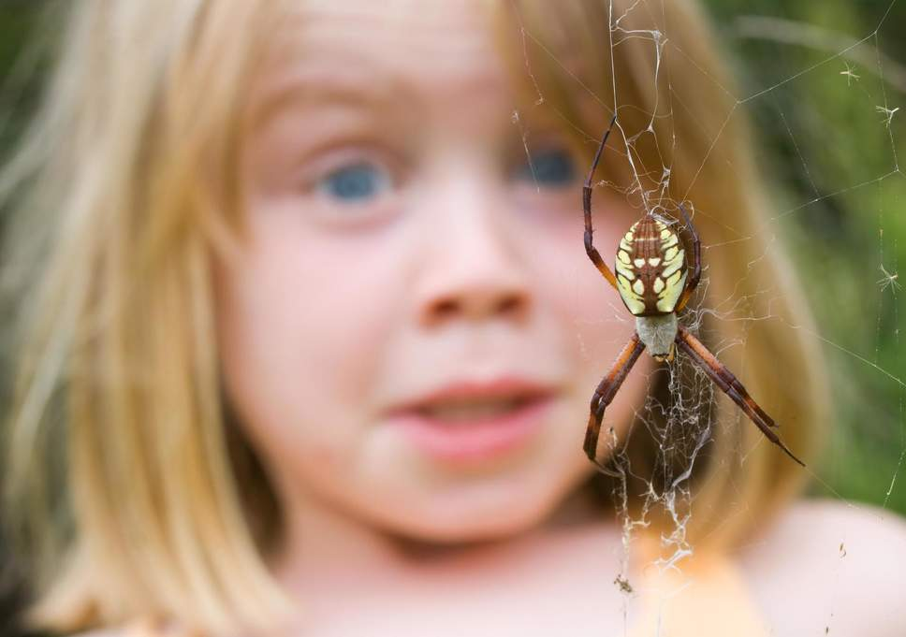
Behaviour
Why ‘ALL ….I want’?
Why is fear mentioned?
Who is ‘NOONE’ ?
What is the price? What are you willing to pay?
“Behaviour is the way in which one acts or conducts oneself, especially towards others.”
(Oxford dictionary 2019, online)
Notes:
Exercise…

Slide 84
Behaviour influences attitude
Why ‘ALL ….I want’?
Why is fear mentioned?
Who is ‘NOONE’ ?
What is the price? What are you willing to pay?
Can we change our behaviour through changing attitudes?
Notes:
Ask question before showing video

Slide 85
Line-up
Why ‘ALL ….I want’?
Why is fear mentioned?
Who is ‘NOONE’ ?
What is the price? What are you willing to pay?
Agree to the statement -> close to the circle
Completely disagree with the statement -> next to the wall
Share your views / ideas and listen to others
You can reposition yourself
Share ideas behind final position
Notes:
Exercise 26: Line-up

Slide 86
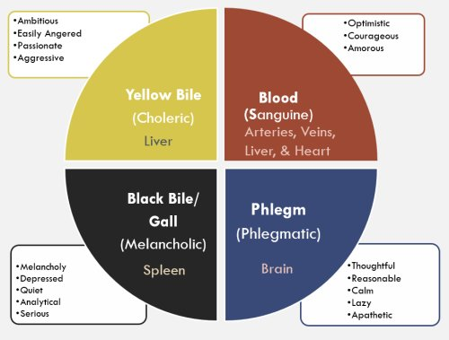
Temperament
Why ‘ALL ….I want’?
Why is fear mentioned?
Who is ‘NOONE’ ?
What is the price? What are you willing to pay?
Temperament: “lifelong characteristics that we have gained early on in life or simply inherited.”
Example: Being sporty/social
What are some other kind of temperaments? Do the test.
How do each of the temperamental factors affect you on a leadership role level?
Which of these factors do you want to change and why?
Notes:
Exercise 27: Temperaments

Slide 87
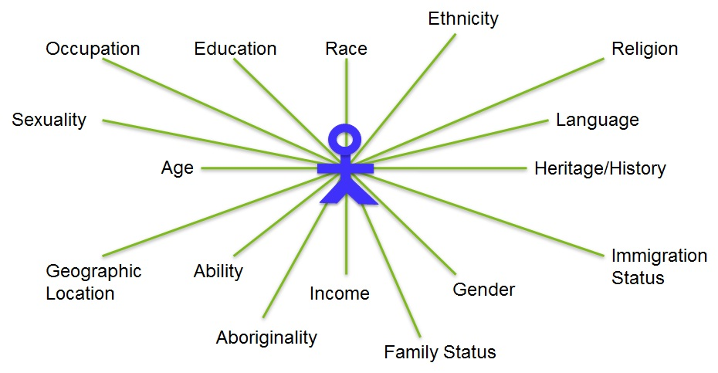
Homework
Why ‘ALL ….I want’?
Why is fear mentioned?
Who is ‘NOONE’ ?
What is the price? What are you willing to pay?
Positionality is the social and political context that creates your identity in terms of race, class, gender, sexuality, and ability status. But also where you stand in relation to the ‘other’.
It describes how your identity influences, and potentially biases, your understanding of and outlook on the world.
Draw your own positioning in relation to your current circumstances. How do you position yourself in your current environment?
Notes:
Exercise 28: Positionality

Slide 88
Welcome Session 5

Slide 89
Secret identity
Notes:
Exercise 28: Secret identity

Slide 90
Session outline
1. Democracy
Representation
Civil Societies
Rights & Freedoms
2. Human Rights & Conflict
Rights & Freedoms
Positions vs. Interests
Conflict Styles
3. Identity & Leadership
Culture
Gender Roles/ Awareness
Prejudice/ Discrimination
4. Confidence Building
Values
Attitude
Behaviour
5. “What’s Next?”
Positionality
Future
Feedback/ Evaluation

Slide 91
Positionality
Why ‘ALL ….I want’?
Why is fear mentioned?
Who is ‘NOONE’ ?
What is the price? What are you willing to pay?
Present homework assignment

Slide 92
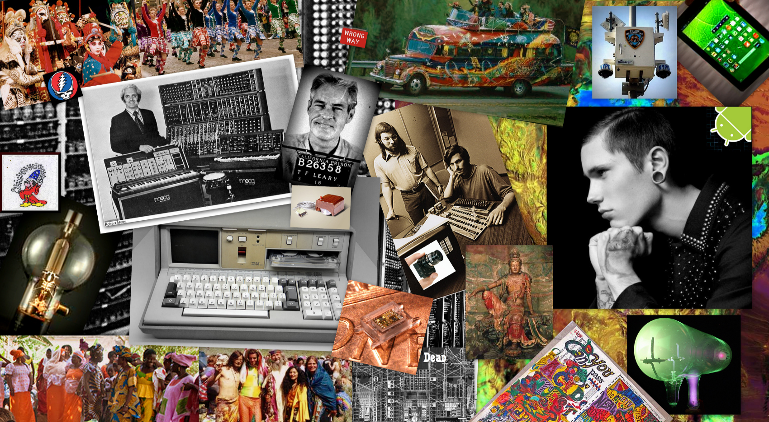
How do you get to where you need to be?
Why ‘ALL ….I want’?
Why is fear mentioned?
Who is ‘NOONE’ ?
What is the price? What are you willing to pay?
Future collage
Notes:
Exercise 29: Collage

Slide 93
Presenting your future
Why ‘ALL ….I want’?
Why is fear mentioned?
Who is ‘NOONE’ ?
What is the price? What are you willing to pay?
Think of informal channels which can help you to get where you want to be:
Search for link minded people to kickstart your future dreams
Volunteering with civil society organisation
Ask for an internship/apprenticeship
Notes:
Exercise 30: Presenting future

Slide 94
Presenting your future
Why ‘ALL ….I want’?
Why is fear mentioned?
Who is ‘NOONE’ ?
What is the price? What are you willing to pay?
Take this opportunity
Step out of your comfort zone
Share your future with us
The floor is yours

Slide 95
Break
Indicate number of minutes

Slide 96
Solarium
Why ‘ALL ….I want’?
Why is fear mentioned?
Who is ‘NOONE’ ?
What is the price? What are you willing to pay?
Reflect the course
Select 3 pictures which reflect what your have gained/learned during the course/trainning
Select 3 pictures which identify areas for improvement of the course/trainning
Notes:
Exercise 32: Solarium

Slide 97
Evaluation
Why ‘ALL ….I want’?
Why is fear mentioned?
Who is ‘NOONE’ ?
What is the price? What are you willing to pay?
Shared expectations in session 1
Vote – achieved – not achieved
Share what you missed during the course
Share what you gained/learned during this course
Notes:
Exercise 34: Evaluation

Slide 98
For all your input
Notes:
Excersize ..

